Slide 1
PPS Adjusted Dl and UL Throughput metrics
Raimundas Gaigalas, Anders Persson A
Notes:
2014-11-12
75/0363-10/FCP 130 4300/14 Uen, Rev PA47
PPS Adjusted DL and UL Throughput metrics

Slide 2
MR 23815 Adjusted UL UE Throughput metric
UL MAC throughput:
  New throughput metrics shall be available on MAC level that reflects air interface performance.
  The metrics shall be available as counters and events.
  Existing counters shall be maintained.
  Burst length metric shall be provided on MAC level. (optional)
UL PDCP throughput:
  New UL throughput metrics shall be defined on PDCP level that enable a higher alignment between network KPIs and end-user performance experience.
  Throughput distribution counters shall be provided for the new PDCP throughput metrics with a resolution high enough to track cell edge performance.
  Differentiation based on LCG shall be provided.
  A burst size metric shall be provided on PDCP level. (optional)
The feature shall be part of an optional package.
Notes:
2014-11-12
PPS Adjusted DL and UL Throughput metrics
75/0363-10/FCP 130 4300/14 Uen, Rev PA47

Slide 3
Description of Problem Area, UL MAC throughput
UL MAC UE and LCG active time filtered on the “first four” and the “last transmission”
  UL MAC active time pmUeThpTimeUl per UE counters do not count time for the first four data transmissions and the last TTI in all “aggregated” MAC bursts per UE. UL MAC active time pmLcgThpTimeUlLcg per LCG counters do not count time for the first four data transmissions and from the next to the last transmission in all MAC bursts per LCG. Separate counters for the total active time and removed transmissions would be preferable.
HARQ retransmissions are not counted as UL MAC active time
  Only the last successful transmission is counted today as UL MAC active time by pmUeThpTimeUl and pmLcgThpTimeUlLcg counters. Counting HARQ retransmissions requires “backdate” pegging when CRC OK data is received.
Padding bits included into UL MAC volume
  UL MAC volume pmRadioThpVolUl includes padding. This may give inconsistent results for e.g. Pre-scheduling feature which may result in “padding-only” transmissions from the UE.
Long UL MAC throughput reporting period
  Only aggregated values for 15 min ROP for all active time and volume counters on MAC layer are available. It would be preferable to have more instantaneous reporting.
Notes:
2014-11-12
PPS Adjusted DL and UL Throughput metrics
75/0363-10/FCP 130 4300/14 Uen, Rev PA47

Slide 4
Description of Problem Area, UL PDCP throughput
  UL PDCP throughput KPI estimated by UL MAC throughput
    UL PDCP UE and LCG throughput is estimated by filtered UL MAC UE and LCG throughput. This may give inconsistent results due to the filtering and also due to the protocol effects.
      UL MAC volume pmUeThpVolUl and active time pmUeThpTimeUl per UE counters do not count time for the first four data transmissions and the last TTI in all “aggregated” MAC bursts per UE. UL MAC volume pmLcgThpTimeUlLcg and active time pmLcgThpTimeUlLcg per LCG counters do not count time for the first four data transmissions and from the next to the last transmission in all MAC bursts per LCG. Small transmissions are removed by the filtering.
      Since volume is counted on the MAC layer, PDCP and RLC PDU headers are counted as data.
      Since active time is counted on the MAC layer, RLC retransmissions, SRB transmissions and status PDUs for the opposite link are counted as new transmissions.
  No UL MAC latency counters
  Queueing delays on MAC layer are seen as active time delays on PDCP layer. There are no latency counters for UL MAC counting the time since an SR is received until the first data with CRC OK is received in the eNodeB. This may be a significant delay for the end-to-end application performance in UL.
  UL PDCP volume counters per QCI, active time counters per LCG
    UL PDCP volume pmPdcpVolUlDrbQci counts total UL PDCP PDU volume per QCI while MAC active time pmLcgThpTimeUlLcg counters are per LCG. Today the KPI is estimated by MAC throughput per LCG.
  Continued on the next page
Notes:
2014-11-12
PPS Adjusted DL and UL Throughput metrics
75/0363-10/FCP 130 4300/14 Uen, Rev PA47

Slide 5
Problem Area, UL PDCP throughput cont.
  UL UE PDCP throughput not compatible with Pre-scheduling feature
    UL MAC active time counters are pegged if BSR>0 has been received from the UE and hence does not count data transmissions due to pre-scheduling grants. This however is not noticeable in the current KPIs due to the filtering on the first four data receptions. UE PDCP active time should start with pre-scheduling grants that result in data transmissions but skip the pre-scheduling grants with padding-only transmissions. This requires a “backdate” pegging mechanism when data is received instead of when granting the UE as today.
Notes:
2014-11-12
PPS Adjusted DL and UL Throughput metrics
75/0363-10/FCP 130 4300/14 Uen, Rev PA47

Slide 6
Description of Problem Area, UL cell Kpis
Distribution based on the UL UE throughput filtered on the “first four transmissions” and the “last TTI”
  Current UE throughput distribution per cell is based on the filtered MAC throughput KPIs
    It would be desirable to also observe distribution over unfiltered UE UL MAC throughput in the cell
    It would be desirable to also observe distribution over unfiltered UE UL PDCP throughput in the cell
Large granularity for UE throughput distribution per cell
  Granularity of the pdf counters for UE throughput distribution per cell pmUeThpUlDistr is a way too large. The bins are too few for the very low and very high rates.
Long time averaging period for samples in the UE throughput distribution per cell
  Each throughput sample in the pdf counter for UE throughput distribution per cell pmUeThpUlDistr is a time average over 15 min ROP. It would be preferable to have more instantaneous reporting.
UL PDCP throughput per cell not compatible with Pre-scheduling feature
  Counter pmSchedActivityUlCell used today in UL PDCP throughput per cell KPI is pegged if BSR>0 has been received from the UE and hence does not count data transmissions due to pre-scheduling grants. This results in that PDCP cell throughput KPI incorrectly increases with pre-scheduling (TR HS97739). A new counter for UE PDCP activity is needed that counts pre-scheduling grants that result in data transmissions but does not count pre-scheduling grants with padding-only transmissions. This requires a “backdate” pegging mechanism when data is received instead of when granting the UE as today.
Notes:
PPS Adjusted DL and UL Throughput metrics
2014-11-12
75/0363-10/FCP 130 4300/14 Uen, Rev PA47
LTE System Design Process - Pre-prestudy
2/155 01-FCP 103 7306 Uen, Rev PD3

Slide 7
MR 23736 Adjusted DL UE Throughput metric
DL MAC throughput:
  New throughput metrics shall be available on MAC level that reflects air interface performance.
  The metrics shall be available as counters and events.
  Existing counters shall be maintained.
  Burst length metric shall be provided on MAC level. (optional)
DL PDCP throughput:
  New DL throughput metrics shall be defined on PDCP level that enable a higher alignment between network KPIs and end-user performance experience.
  Throughput distribution counters shall be provided for the new PDCP throughput metrics with a resolution high enough to track cell edge performance.
  Differentiation based on QCI shall be provided.
  A burst size metric shall be provided on PDCP level. (optional)
The feature shall be part of an optional package.
Notes:
2014-11-12
PPS Adjusted DL and UL Throughput metrics
75/0363-10/FCP 130 4300/14 Uen, Rev PA47

Slide 8
Description of Problem Area, DL MAC throughput
DL MAC active time filtered on the last transmission
  DL MAC active time pmUeThpTimeDl per UE counter does not count time for the last TTI in the “aggregated” PDCP bursts per UE. DL MAC active time pmDrbThpTimeDlQci per QCI counters do not count TTIs after the next to the last data transmissions in all PDCP bursts per RB. Separate counters for the total active time and removed transmissions would be preferable.
HARQ retransmissions for the last transmission are not counted as DL MAC active time
  DL MAC active time pmUeThpTimeDl and pmDrbThpTimeDlQci counters are stopped when PDCP SDU buffer is emptied. Then the last TTI is removed from pmUeThpTimeDl and the time until next to the last transmission is removed from pmDrbThpTimeDlQci. So possible HARQ retransmissions for the last transmission are not counted. Counting HARQ retransmissions for the last transmission requires “backdate” pegging when HARQ ACK is received.
Long DL MAC throughput reporting period
  Only aggregated values for 15 min ROP for all active time and volume counters on MAC layer are available. It would be preferable to have more instantaneous reporting.
Notes:
2014-11-12
PPS Adjusted DL and UL Throughput metrics
75/0363-10/FCP 130 4300/14 Uen, Rev PA47

Slide 9
Description of Problem Area, DL PDCP throughput
DL PDCP volume and active time filtered on the “last transmission”
  Current filtering on the last data transmission in each PDCP burst in DL is adjusted to large file downloads in good radio environment with a small number of active UEs in a cell. The KPIs are not well suited for small transmissions or transmissions distributed over time and frequency. It may give inconsistent results for e.g. Frequency Selective Scheduling.
DL PDCP active time estimated by DL MAC active time
  There are no counters for DL PDCP active time. Current PDCP throughput KPIs are based on active time counters on MAC level. This may give inconsistent results due to e.g. that RLC status PDUs for the opposite link are counted as new transmissions on MAC level. Also, PDCP burst arrival and last active time estimation is rather difficult.
DL PDCP throughput KPI does not include MAC queueing delays
  Queueing delays on MAC layer are seen as active time delays on PDCP layer. Right now DL PDCP active time is estimated by the DL MAC active time and does not include MAC queueing delays (counters pmPdcpLatTimeDl and pmPdcpLatTimeDlQci).
Notes:
PPS Adjusted DL and UL Throughput metrics
2014-11-12
75/0363-10/FCP 130 4300/14 Uen, Rev PA47
LTE System Design Process - Pre-prestudy
2/155 01-FCP 103 7306 Uen, Rev PD3

Slide 10
Description of Problem Area, DL cell Kpis
Distribution based on the DL UE throughput filtered on the “last TTI”
  Current UE throughput distribution per cell is based on the current PDCP throughput KPIs which include filtering and are based on active time estimates on MAC level.
    It would be desirable to also observe distribution over unfiltered UE DL PDCP throughput in the cell
Large granularity for DL UE throughput distribution per cell
  Granularity of the pdf counters for DL UE throughput distribution per cell pmUeThpDlDistr is a way too large. The bins are too few for the very low and very high rates.
Long time averaging period for samples in the DL UE throughput distribution per cell
  Each throughput sample in the pdf counter for DL UE throughput distribution per cell pmUeThpDlDistr is a time average over 15 min ROP. It would be preferable to have more instantaneous reporting.
Notes:
PPS Adjusted DL and UL Throughput metrics
2014-11-12
75/0363-10/FCP 130 4300/14 Uen, Rev PA47
LTE System Design Process - Pre-prestudy
2/155 01-FCP 103 7306 Uen, Rev PD3

Slide 11
Suggested Solution, UL
Minimum ambition level
  More exact UL MAC UE and LCG throughput:
    Remove filtering on the first four and the last transmission
      Additional UL MAC volume and active time counters per UE and per LCG that count all data transmissions in MAC bursts.
    Include HARQ retransmission delay into UL MAC active time
      Newly added UL MAC active time counters per UE and per LCG shall count HARQ retransmission delays
    New UL MAC burst sample counter per UE
      Number of effective active time periods aggregated in the unfiltered UL MAC active time counters during the measurement time interval provide information on “average” MAC burst volume and active time
  More exact UL PDCP UE and LCG throughput:
    Remove filtering on the first four and the last transmission
      New UL PDCP throughput KPIs per UE and LCG based on the unfiltered volume and active time counters
    Count UL PDCP volume on PDCP layer instead of MAC
      Additional UL PDCP volume counters per LCG that count all data transmissions in MAC bursts.
      Include the existing UL UE PDCP volume pmPdcpVolUlDrb into the KPI
    UL PDCP active time counters should be compatible with Pre-scheduling
      The new UL active time counters per UE and per LCG should start with pre-scheduling grants that result in data transmissions but skip the pre-scheduling grants with padding-only transmissions.
Continued on the next page
Notes:
PPS Adjusted DL and UL Throughput metrics
2014-11-12
75/0363-10/FCP 130 4300/14 Uen, Rev PA47
LTE System Design Process - Pre-prestudy
2/155 01-FCP 103 7306 Uen, Rev PD3

Slide 12
Suggested Solution, UL cont.
Minimum ambition level, continued
  More exact UL cell throughput KPIs
    Configurable histogram bin sizes for UL UE throughput distribution per cell
    Smaller time averaging period for the samples in the UL UE throughput distribution per cell
    Additional UL PDCP throughput PIs on cell level
      Distribution for UL PDCP UE throughput in a cell for the filtered UL PDCP throughput with smaller granularity
      Distribution for UL PDCP UE throughput in a cell for the unfiltered UL PDCP throughput
    New PDCP UE activity counter per cell compatible with Pre-scheduling
      The counter should count pre-scheduling grants that result in data transmissions but does not count pre-scheduling grants with padding-only transmissions.
Higher ambition level
  Count UL PDCP active time on PDCP layer instead of MAC
    Additional UL PDCP active time counters per UE and per LCG measured on PDCP layer
Notes:
PPS Adjusted DL and UL Throughput metrics
2014-11-12
75/0363-10/FCP 130 4300/14 Uen, Rev PA47
LTE System Design Process - Pre-prestudy
2/155 01-FCP 103 7306 Uen, Rev PD3

Slide 13
Proposed Changes, UL MAC
New UL MAC UE and LCG throughput metrics
  New UL MAC UE throughput KPI (current volume counters are unfiltered but active time counters are filtered – no KPI)
  Remove filtering on the first four and the last transmission in MAC bursts
  Include HARQ retransmission delay into UL MAC active time
  New UL MAC burst sample counter per UE
Type | Current counters and KPIs | New counters and KPIs | Changes
MAC | pmRadioThpVolUl | UL MAC UE Throughput = pmRadioThpVolUl / pmRadioThpTimeTotalUl | New UL MAC UE active time counter: -No filtering on the first four and the last transmissions -Include HARQ retransmission delays -Count all pre-scheduling grants
MAC | MAC burst characteristics: none | Average UL MAC UE burst volume = pmRadioThpVolUl / pmUeMacThpTimeTotalUlSamp Average UL MAC UE burst active time = pmUeMacThpTimeTotalUl / pmUeMacThpTimeTotalUlSamp | New UL MAC burst sample counter per UE
Notes:
2014-11-12
PPS Adjusted DL and UL Throughput metrics
75/0363-10/FCP 130 4300/14 Uen, Rev PA47

Slide 14
Proposed Changes, UL PDCP
New UL PDCP UE and LCG throughput metrics:
  Remove filtering on the first four and the last transmission in MAC bursts
  Include HARQ retransmission delay into UL PDCP active time
  Count UL PDCP volume on PDCP layer instead of MAC
  UL PDCP active time counters should be compatible with Pre-scheduling
Type | Current counters and KPIs | New counters and KPIs | Changes
PDCP | UL UE Throughput = pmUeThpVolUl / pmUeThpTimeUl pmPdcpVolUlDrb | UL PDCP UE Throughput = pmPdcpVolUlDrb / pmUeMacThpTimeTotalUl | New UL MAC active time counter: -No filtering on the first four and the last transmissions -Include HARQ retransmission delays -PDCP handling of pre-scheduling grants -Count UL PDCP volume on PDCP layer instead of MAC
PDCP | UL UE Throughput per LCG = pmLcgThpVolUlLcg / pmLcgThpTimeUlLcg | UL UE Throughput per LCG = pmUePdcpVolUlLcg / pmUeMacThpTimeTotalUlLcg | New UL PDCP volume counter per LCG New UL MAC active time counter per LCG: -No filtering on the first four and the last transmissions -Include HARQ retransmission delays -PDCP handling of pre-scheduling grants -Count UL PDCP volume on PDCP layer instead of MAC
Notes:
2014-11-12
PPS Adjusted DL and UL Throughput metrics
75/0363-10/FCP 130 4300/14 Uen, Rev PA47

Slide 15
Proposed Changes, UL Cell throughput
New UL cell throughput metrics
  Configurable histogram bin sizes for UL UE throughput distribution per cell
  Smaller time averaging period for the samples in the UL UE throughput distribution per cell
  Additional UL PDCP throughput PIs on cell level
  New PDCP UE activity counter per cell compatible with Pre-scheduling
Type | Current counters and KPIs | New counters and KPIs | Changes
Cell | Average number of active UEs in UL = pmActiveUeUlSum / pmSchedActivityCellUl | Average number of active UEs in UL = pmActiveUeUlSum / pmRbActivityCellUl | New UE PDCP activity counter per cell: -Correct handling of pre-scheduling grants
Cell | pmUeThpUlDistr | pmUeThpTtiFilteredUlDistr, pmUeThpTotalUlDistr | New UL UE throughput distribution counters: -One distribution for the current filtered throughput, one for the unfiltered throughput -Configurable histogram bin sizes -Shorter time averaging period for the throughput samples
Notes:
2014-11-12
PPS Adjusted DL and UL Throughput metrics
75/0363-10/FCP 130 4300/14 Uen, Rev PA47

Slide 16
Suggested Solution, dL
Minimum ambition level
  More exact DL MAC UE and QCI throughput:
    Remove active time filtering on the last transmission
      Additional DL MAC active time counters per UE and per QCI that count all data transmissions in PDCP bursts.
    New DL MAC burst sample counter per UE
      Number of effective active time periods aggregated in the unfiltered DL MAC active time counters during the measurement time interval provide information on “average” MAC burst volume and active time
  More exact DL PDCP UE and QCI throughput:
    Remove active time filtering on the last transmission
      New DL PDCP throughput KPIs per UE and QCI based on the unfiltered volume and active time counters
    Include MAC queueing delays into DL PDCP throughput KPIs
      Include the existing DL MAC queueing delay counters pmPdcpLatTimeDl and pmPdcpLatTimeDlQci into the KPIs
Continued on the next page
Notes:
PPS Adjusted DL and UL Throughput metrics
2014-11-12
75/0363-10/FCP 130 4300/14 Uen, Rev PA47
LTE System Design Process - Pre-prestudy
2/155 01-FCP 103 7306 Uen, Rev PD3

Slide 17
Suggested Solution, dL cont.
Minimum ambition level, continued
  More exact DL cell throughput KPIs
    Configurable histogram bin sizes for DL UE throughput distribution per cell
    Smaller time averaging period for the samples in the DL UE throughput distribution per cell
    Additional DL PDCP throughput PIs on cell level
      Distribution for DL PDCP UE throughput in a cell for the filtered DL PDCP throughput with smaller granularity
      Distribution for DL PDCP UE throughput in a cell for the unfiltered DL PDCP throughput
Higher ambition level
  Count DL PDCP active time on PDCP layer instead of MAC
    Additional DL PDCP active time counters per UE and per QCI measured on PDCP layer
Notes:
PPS Adjusted DL and UL Throughput metrics
2014-11-12
75/0363-10/FCP 130 4300/14 Uen, Rev PA47
LTE System Design Process - Pre-prestudy
2/155 01-FCP 103 7306 Uen, Rev PD3

Slide 18
Proposed Changes, DL MAC
New DL MAC UE throughput KPI
  New DL MAC UE throughput KPI (current volume counters are unfiltered but active time counters are filtered – no KPI)
  Remove filtering on the last transmission in PDCP bursts
  Include HARQ retransmission delays into MAC active time
  New DL MAC burst sample counter per UE
Type | Current counters and KPIs | New counters and KPIs | Changes
MAC | pmRadioThpVolDl, pmRadioThpVolDlSCell | DL MAC UE Throughput = pmRadioThpVolDl / pmRadioThpTimeTotalDl | New DL MAC active time counter: -No filtering on “the last TTI” -Include HARQ retransmission delays?
MAC | MAC burst characteristics: none | Average DL MAC UE burst volume = pmRadioThpVolDl / pmRadioThpTimeTotalDlSamp Average DL MAC UE burst transfer time = pmRadioThpTimeTotalDl / pmRadioThpTimeTotalDlSamp | New DL MAC burst sample counter per UE
Notes:
2014-11-12
PPS Adjusted DL and UL Throughput metrics
75/0363-10/FCP 130 4300/14 Uen, Rev PA47

Slide 19
Proposed Changes, DL PDCP
New DL PDCP UE and QCI throughput metrics:
  Remove filtering on the last transmission in PDCP bursts
  Include HARQ retransmission delays into MAC active time
  Include MAC queueing delays into DL PDCP throughput KPIs
Type | Current counters and KPIs | New counters and KPIs | Changes
PDCP | DL PDCP UE Throughput = (pmPdcpVolDlDrb – pmPdcpVolDlDrbLastTTI) / pmUeThpTimeDl | DL PDCP UE Throughput = pmPdcpVolDlDrb / (pmRadioThpTimeTotalDl + pmPdcpLatTimeDl) | New DL MAC transfer time counter: -No filtering on “the last TTI” -Include HARQ retransmission delays? Include MAC queueing delays into the KPI
PDCP | DL PDCP UE Throughput per QCI = (pmPdcpVolDlDrbQci – pmPdcpVolDlDrbLastTTIQci) / pmDrbThpTimeDlQci | DL PDCP UE Throughput per QCI = pmPdcpVolDlDrbQci / (pmDrbThpTimeTotalDlQci + pmPdcpLatTimeDlQci) | New DL MAC transfer time counter per QCI: -No filtering on the last transmission -Include HARQ retransmission delays? Include MAC queueing delays into the KPI
Notes:
2014-11-12
PPS Adjusted DL and UL Throughput metrics
75/0363-10/FCP 130 4300/14 Uen, Rev PA47

Slide 20
Proposed Changes, DL cell throughput
New DL cell throughput metrics
  Configurable histogram bin sizes for DL UE throughput distribution per cell
  Smaller time averaging period for the samples in the DL UE throughput distribution per cell
  Distribution for DL PDCP UE throughput in a cell for the filtered DL PDCP throughput with smaller granularity
  Distribution for DL PDCP UE throughput in a cell for the unfiltered DL PDCP throughput
  New PDCP UE activity counter per cell (if HARQ retransmissions are included)?
Type | Current counters and KPIs | New counters and KPIs | Changes
Cell | pmUeThpDlDistr | pmUeThpTtiFilteredDlDistr, pmUeThpTotalDlDistr | New DL UE throughput distribution counters: -One distribution for the current filtered throughput, one for the unfiltered throughput -Configurable histogram bin sizes -Shorter time averaging period for the throughput samples
Cell | Average number of active UEs in DL = pmActiveUeDlSum / pmSchedActivityCellDl | Average number of active UEs in UL = pmActiveUeDlSum / pmDrbActivityCellDl | New UE DL PDCP activity counter per cell: -Includes HARQ re-transmissions
Notes:
2014-11-12
PPS Adjusted DL and UL Throughput metrics
75/0363-10/FCP 130 4300/14 Uen, Rev PA47

Slide 21
Benefit for Operator/Ericsson/other
Additional counters for UL and DL MAC throughput:
  More exact UL MAC throughput KPIs per UE and per LCG with possibility to filter out the last data transmissions in MAC bursts: more relevant for air-interface performance
  More exact DL MAC throughput KPIs per UE and per QCI with possibility to filter out the last data transmissions in PDCP bursts: more relevant for air-interface performance
Additional counters for UL and DL PDCP throughput:
  UL PDCP throughput KPIs per UE and per LCG more relevant to end-to-end application throughput
  DL PDCP throughput KPIs per UE and per QCI more relevant to end-to-end application throughput
  Additional PDCP throughput-based PIs on cell level:
    PDCP throughput-based PIs on cell level more relevant to end-to-end application throughput and adapted to different traffic types
Notes:
PPS Adjusted DL and UL Throughput metrics
2014-11-12
75/0363-10/FCP 130 4300/14 Uen, Rev PA47
LTE System Design Process - Pre-prestudy
2/155 01-FCP 103 7306 Uen, Rev PD3

Slide 22
NETWORK IMPACT
Except the positive impact described as Operator Benefit, list other impact on Network
  Positive/Negative impact in KPIs (description available in CPI)
  Positive/Negative on HW resources (e.g. MP Load, Memory, etc)
Notes:
PPS Adjusted DL and UL Throughput metrics
2014-11-12
75/0363-10/FCP 130 4300/14 Uen, Rev PA47
LTE System Design Process - Pre-prestudy
2/155 01-FCP 103 7306 Uen, Rev PD3

Slide 23
MR 23815 (UL MAC)
New throughput metrics shall be available on MAC level that reflects air interface performance
  Proposed solution
    New active time counter on MAC, per user and LCG
      Don’t discard 4 first TBs and last TTI (as is the case today)
      Add known time due to HARQ re-TX, grant delay, and initial queuing delay
    New volume counter on MAC , per user and LCG
      Don’t discard 4 first and last TB (as is the case today)
Burst length metric shall be provided on MAC level
  This requirement was removed after meeting with Paul T., 2014-08-12.
The metrics shall be available as counters and events
  According to Section 6.5 in 30/155 60–CSH103704, events are not supported. According to Andreas Olsson AB, events are supported. According to Allan Brady, this is not possible. ➔ Unclear if this can be supported.
Existing counters shall be maintained
  OK
The feature shall be part of an optional package
  OK
Notes:
2014-11-12
PPS Adjusted DL and UL Throughput metrics
75/0363-10/FCP 130 4300/14 Uen, Rev PA47

Slide 24
MR 23815 (UL PDCP)
New UL throughput metrics shall be defined on PDCP level that enables a higher alignment between network KPIs and end-user performance experience
  Proposed solution
    A new measure for the active time on MAC (see previous page)
    Existing volume counters on PDCP
    Approximate compensation for RLC status PDUs in acknowledged mode
      Count the relative status PDU volume overhead, and use this to down-scale the active time. I.e., assuming x% relative volume overhead, compute the PDCP-throughput estimate as
        pdcpThroughput = pdcpVolume / ( macActiveTime * (1.0 – x/100) )
Throughput distribution counters shall be provided for the new PDCP throughput metrics with a resolution high enough to track cell edge performance
  Proposed solution
    The new histogram resolution is TBD.
A burst size metric shall be provided on PDCP level
  This requirement was removed after meeting with Paul T., 2014-08-12.
Differentiation based on LCG shall be provided
  Proposed solution
    By combining (adding) the PDCP volume for radio bearers mapped to a certain LCG, we can present a PDCP throughput metric per LCG.
Notes:
2014-11-12
PPS Adjusted DL and UL Throughput metrics
75/0363-10/FCP 130 4300/14 Uen, Rev PA47

Slide 25
New counters in UL
No | Counter | Type in cost est | Definition
1 | pmUeMacThpTimeTotalUl | MAC | The effective UL MAC active time comprises of time periods from when the first grant for the first MAC SDU data reception is issued until the buffer is emptied including the TTI when the buffer is emptied. Unit: 1 ms
2 | pmUeMacThpTimeTotalUlSamp | MAC | Number of time periods aggregated in the effective UL MAC active time during the measurement time interval. One time period sample starts when the first grant for the first MAC SDU data reception is issued and ends when the buffer is emptied including the TTI when the buffer is emptied. Unit: 1
3 | pmUeMacThpTimeTotalUlLcg | MAC | The effective UL MAC active time per LCG. It comprises of time periods from when the first grant for the first MAC SDU data reception is issued until the buffer is emptied including the TTI when the buffer is emptied. Unit: 1 ms
4 | pmUePdcpVolUlLcg | PDCP | The total volume (PDCP SDU) that has been received on Data Radio Bearers in the uplink direction per LCG. Unit: 1 kilobit (1 000 bits)
5 | pmRlcArqStatusUlVol | PDCP (RLC) | The total volume of DL RLC AM Status PDUs transmitted in the uplink direction. Unit: 1 kilobit (1 000 bits)
Notes:
2014-11-12
PPS Adjusted DL and UL Throughput metrics
75/0363-10/FCP 130 4300/14 Uen, Rev PA47

Slide 26
New counters in UL cont.
No | Counter | Type in cost est | Definition
6 | pmUeThpTtiFilteredUlDistr | Cell | Distribution of the UL UE throughput. One UL UE throughput sample is obtained by dividing the total volume (PDCP SDU) on Data Radio Bearers per UE, that has been received in the uplink direction with a time interval applicable to the volume measurement. Both the measured volume and time does not count the first four data transmissions in each data burst and the TTI when the buffer is emptied.
7 | pmUeThpTotalUlDistr | Cell | Distribution of the UL UE throughput. One UL UE throughput sample is obtained by dividing the total volume (PDCP SDU) on Data Radio Bearers per UE, that has been received in the uplink direction with a time interval applicable to the volume measurement.
8 | pmRbActivityCellUl | Cell | The aggregated number of ms in which DRB data was required to be scheduled in the uplink.
9 | pmUeMacThpTimeTotalUlDistr | Cell | Distribution of the effective UL MAC active time. One sample is obtained by aggregating time periods for the active time over the measurement period. One time period starts when the first grant for the first MAC SDU data reception is issued and ends when the buffer is emptied including the TTI when the buffer is emptied.
10 | pmRadioThpVolUlDistr | Cell | Distribution of the successfully transferred data volume on MAC level in the uplink including possible padding bits. One sample is obtained by aggregating the volume over the measurement period.
Notes:
2014-11-12
PPS Adjusted DL and UL Throughput metrics
75/0363-10/FCP 130 4300/14 Uen, Rev PA47

Slide 27
New Kpis in UL
UL MAC UE Throughput =
pmRadioThpVolUl / pmUeMacThpTimeTotalUl
UL PDCP UE Throughput =
pmPdcpThpVolUl / pmUeMacThpTimeTotalUl
UL UE Throughput per LCG =
pmUePdcpVolUlLcg / pmUeMacThpTimeTotalUlLcg
Average number of active UEs in UL = pmActiveUeUlSum / pmRbActivityCellUl
Average UL MAC UE burst volume = pmRadioThpVolUl / pmUeMacThpTimeTotalUlSamp
Average UL MAC UE burst active time =
pmUeMacThpTimeTotalUl / pmUeMacThpTimeTotalUlSamp
pmUeThpTtiFilteredUlDistr
pmUeThpTotalUlDistr
New counters are marked in blue.
Notes:
2014-11-12
PPS Adjusted DL and UL Throughput metrics
75/0363-10/FCP 130 4300/14 Uen, Rev PA47

Slide 28
Background / Introduction
Uplink burst definition: Burst-time and burst-volume is defined as the time and volume measured
  From when the UE buffer becomes non-empty
  To when the UE buffer becomes again empty
Aggregation of burst-time and burst-volume is done separately in two steps (Need to get confirmation this is what baseline actually does!)
  First aggregate to 1s resolution (mini-counter) ➔ thpVol1s & thpTime1s
  Thereafter, thpVol1s and thpTime1s are aggregate to 15min resolution (ROP) ➔ thpVol15min & thpTime15min
Average throughput is defined as the ratio of aggregated volume and aggregated time
  avgThp1s = thpVol1s / thpTime1s
  avgThp15min = thpVol15min / thpTime15min
For accurate uplink throughput measurements, on short bursts, it is important to
  Include queuing delay, grant delay, and HARQ re-transmissions
    Today we excludes these delays, but this is often most of the active time!
  Don’t “filter” (i.e., discard parts of uplink bursts)
    Today we discard the first four and last transport blocks, but this is often the whole burst!
Pre-scheduling means we give speculative grants to reduce uplink latency
  Lower delay ➔ Faster buffer draining ➔ Shorter bursts
    Even more important to not perform “filtering”, and to include initial delays!
  Most pre-scheduled grants will be unused (UE buffer is empty)
    Important to exclude “padding only” contribution from counters!
Notes:
2014-11-12
PPS Adjusted DL and UL Throughput metrics
75/0363-10/FCP 130 4300/14 Uen, Rev PA47

Slide 29
Outline of Proposed solutions
Counting throughput time per UE and LCG on MAC (details in flow chart on page 24)
  Introduce a state variable that indicates if the LCG is active
    lcgActive = FALSE
  If we detect (at CRC=OK) that an LCG has volume > 0 in a MAC-PDU, then move into active state and include the initial delay by offsetting the time counter
    lcgActive = TRUE
    macThpTimeLcg = initializationValue
  While in active state, peg the time counter for each TTI
    macThpTimeLcg++
  When the buffer estimate becomes zero, return into passive state
    lcgActive = FALSE
Counting throughput time per UE and LCG on PDCP
  Assumption:
    On average over the ROP (15 min), N bytes of RLC status volume and N bytes of RLC “payload” volume consume the same amount of time
  We can now estimate the PDCP throughput time per LCG via the MAC throughput time per LCG, by compensating for the relative status PDU volume overhead of the bearers mapped to the LCG. I.e., assuming x% relative volume overhead for those bearers, we compute the PDCP-throughput estimate as
    pdcpThpLcg = pdcpVolLcg / ( macThpTimeLcg * (1.0 – x/100) )
Counting volumes per UE and LCG
  MAC throughput per LCG
    Sum of MAC SDU volume for bearers mapped to the LCG
  Relative RLC status PDU overhead per LCG
    x = (sum of RLC status PDU volume for bearers mapped to the LCG) / (total RLC volume for bearers mapped to the LCG) * 100
  PDCP throughput per LCG
    Sum of PDCP volumes for bearers mapped to the LCG
Notes:
2014-11-12
PPS Adjusted DL and UL Throughput metrics
75/0363-10/FCP 130 4300/14 Uen, Rev PA47

Slide 30
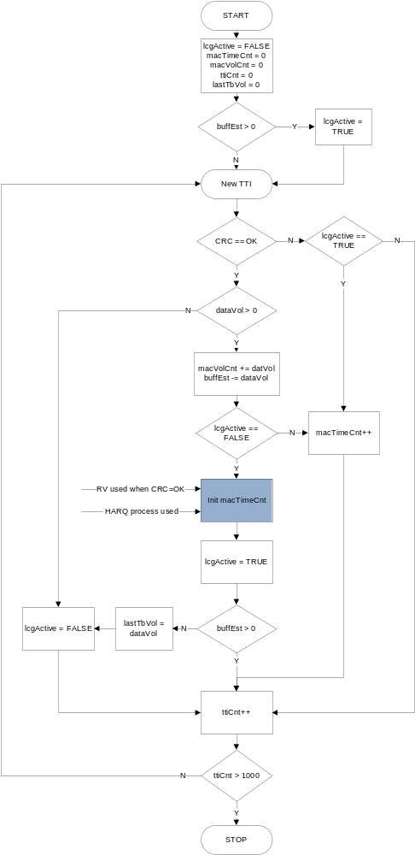
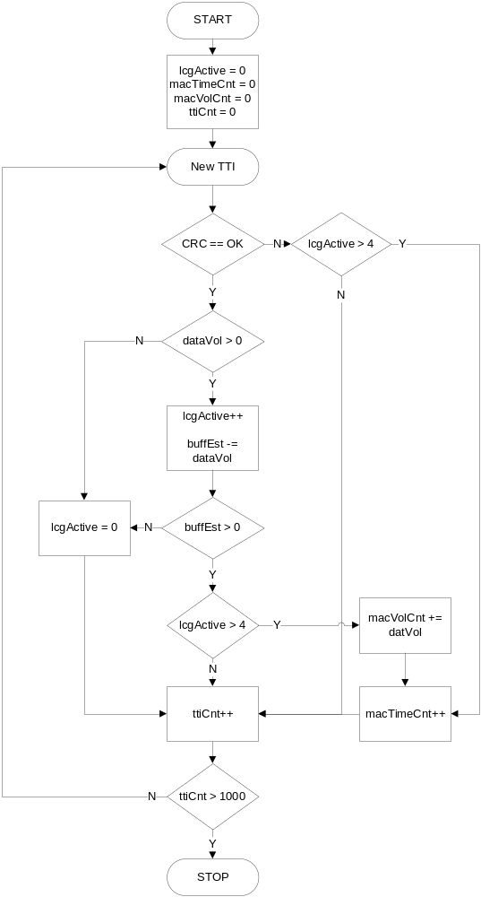
Baseline ?
Fom 30/155 60-CSH 103 704 Uen, pp. 82
Proposed
per UE and LCG
Discards 4 first TBs from both macTimeCnt and macVolCnt
per UE and LCG
Include all TBs
Include known initial time, see next slide. Three different levels of ambition.
Discards last TTI from macTimeCnt and last TB from macVolCnt
To meet the 3GGP requirement of removing the last TB.
Notes:
2014-11-12
PPS Adjusted DL and UL Throughput metrics
75/0363-10/FCP 130 4300/14 Uen, Rev PA47

Slide 31
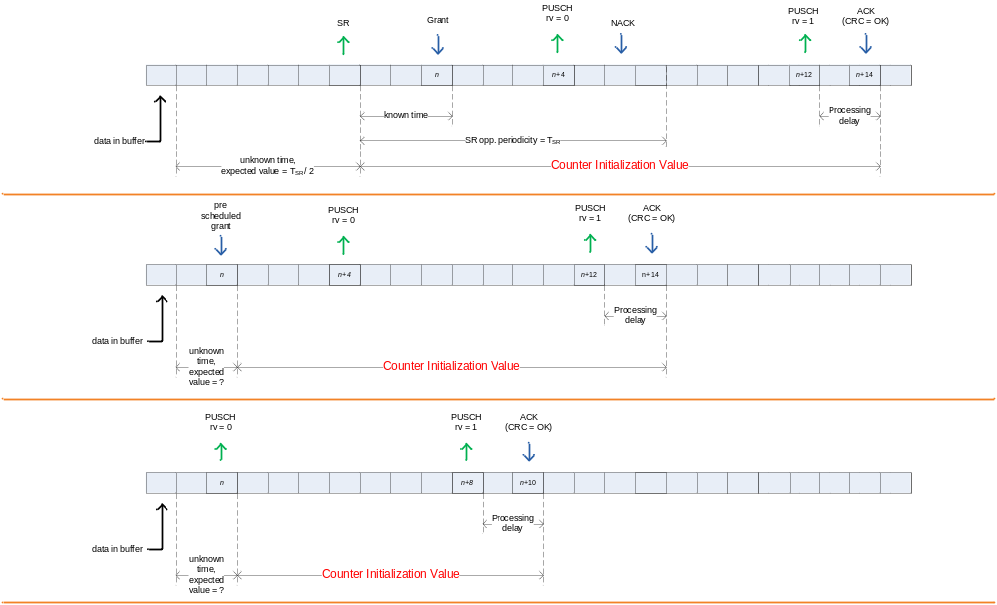
Mac Uplink Time Counter Initialization
Alternative 2:
Include the known grant delay time. ➔ Will capture part of the gain with pre-scheduling.
Alternative 1:
Include the expected value for the (unknown) initial queuing time ➔ Will capture most of the gain with pre-scheduling.
Case A
SR received
Case B
Pre scheduled grant utilized
Alternative 3:
Start counting from the utilized grant ➔ Will not capture the improvement with pre-scheduling.
Case C
Data with higher priority arrives in UE buffer
Notes:
2014-11-12
PPS Adjusted DL and UL Throughput metrics
75/0363-10/FCP 130 4300/14 Uen, Rev PA47

Slide 32
From LCG-throughput to UE- and Cell-throughput
Throughput volumes on UE- and cell-level
  Accumulate LCG volumes to get UE volumes on MAC and PDCP, respectively
  Accumulate UE volumes to get cell volumes on MAC and PDCP, respectively
Throughput time on UE- and cell-level
  Throughput time on MAC is described on the next pages
  To get the throughput time on PDCP, it is proposed that compensation for RLC status PDUs is done using the concept on page 3 (now applied to UE- and cell-level)
Notes:
2014-11-12
PPS Adjusted DL and UL Throughput metrics
75/0363-10/FCP 130 4300/14 Uen, Rev PA47

Slide 33
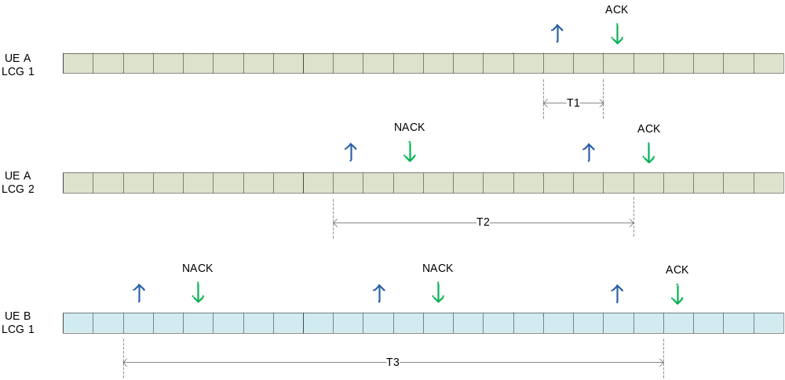
LCG-, UE-, And CELL-ACTIVITY problem description
CELL
UE
The cell is active when at least one UE is active
The UE is active when at least one LCG is active
The LCG is active if it has volume > 0 in a MAC-PDU
  This can be observed when CRC=OK, but active time has started ticking already …
LCG
First observed CRC=OK
UE A becomes active
UE B, and the cell, becomes active
Notes:
2014-11-12
PPS Adjusted DL and UL Throughput metrics
75/0363-10/FCP 130 4300/14 Uen, Rev PA47

Slide 34
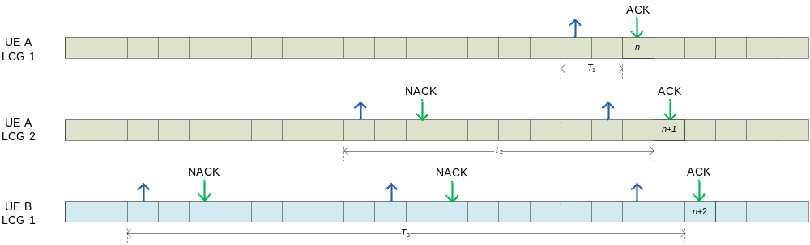
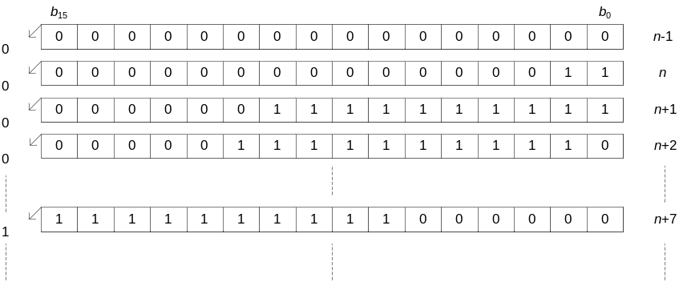
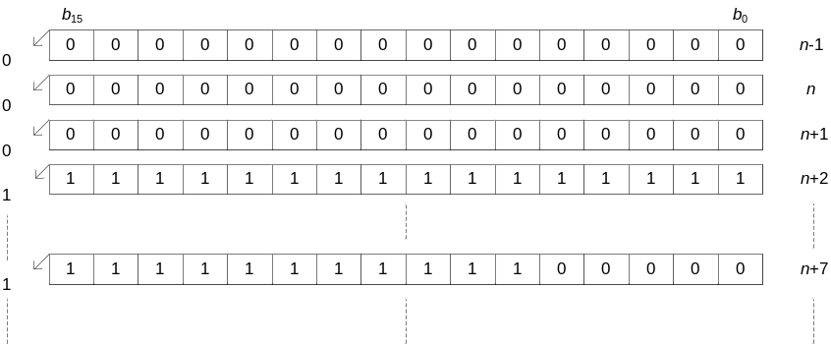
LCG-, UE-, And CELL-ACTIVITY proposed solution
One integer per UE, used as shift register
  A binary “1” indicate the user was active in that TTI
  Bitwise OR to merge the per-LCG activities into a per-UE activity (see previous pages)
    Set bits according to “initialization time” at burst start
      Use bit-mask LUT with the initialization time as input index
    If lcgActive==TRUE, set LSB = 1
  Bit shift up (<<1) for next TTI
  User activity is in the MSB (with a small delay)
    Peg user active time based on this
  Cell activity is the logic OR of the user activities
    Peg cell active time based on this
    The example uses 16 bits but preferably 32 bits is used in the product to provide room for queuing delay and 4 HARQ transmissions.
activityUeA[n]
activityCell[n] = activityUeA[n] OR activityUeB[n]
activityUeB[n]
UE A
UE B
Notes:
2014-11-12
PPS Adjusted DL and UL Throughput metrics
75/0363-10/FCP 130 4300/14 Uen, Rev PA47

Slide 35
Issues, proposed solution UL
MAC counter initialization UP/UPC
  Throughput counters are implemented in UPC but information needed for initialization of the proposed counters is today available only in UP
    Three different ambition levels with different amount of information needed (see previous page).
Measurement accuracy
  PDCP throughput per LCG
    The proposed solution is to combine (add) the volume on PDCP for the radio bearers mapped to a certain LCG, and measure the active time for this LCG on the MAC layer. The presented throughput is therefore the sum-throughput for those bearers.
  RLC status PDU overhead
    The accuracy of the proposed scale-factor solution to compensate for the RLC status PDU overhead needs to be investigated, either via lab measurements or Redhawk simulations.
  If a buffer estimate transitions from empty to non-empty in the current mini-counter interval and becomes again empty in the next interval, active time will be recorded partly in the current interval while volume is recorded entirely in the next interval. This applies to both the baseline and the proposed solutions.
    If volume and time are aggregated separately to report one value every 15th minute, the impact of this should be small when forming the throughput ratio.
Reports using events
  According to Section 6.5 in 30/155 60–CSH103704, events are not supported. According to Andreas Olsson AB, events are supported. According to Allan Brady, this is not possible.
    Unclear if this can be supported
TDD
  Not investigated
Carrier aggregation
  FDD+FDD
    No impact as no CA in uplink?
  TDD+FDD
    Could be significant impact. Not investigated.
Notes:
2014-11-12
PPS Adjusted DL and UL Throughput metrics
75/0363-10/FCP 130 4300/14 Uen, Rev PA47

Slide 36
Issues, Proposed solution UL, Cont.
Do UL MAC volume counters include HARQ retransmissions?
  How to include HARQ retransmissions in TDD?
Are separate counters for grant latency delay needed: time since SR is received until grant is issued? This delay is seen by PDCP layer as active time.
Are burst volume and active time distribution counters needed?
  The current MCS reporting mechanism allows bbRopPeriod (1sec) aggregation period at the best. Otherwise, distribution counters for active time and volume for each burst per UE and per RB (LCG) are needed.
UL PDCP active time estimated by UL MAC active time
  Is a new counter for the RLC status PDU volume needed per LCG?
  Is a new counter needed for the total RLC PDU volume? PDCP SDU volume pmPdcpVolUlDrb could be enough when RLC status PDU volume is evaluated?
  SRB-only transmissions are counted as DRB active time in UL? In case SRBs are multiplexed into the same LCG as DRB data it is hard to detect SRB-only transmissions
Notes:
PPS Adjusted DL and UL Throughput metrics
2014-11-12
75/0363-10/FCP 130 4300/14 Uen, Rev PA47
LTE System Design Process - Pre-prestudy
2/155 01-FCP 103 7306 Uen, Rev PD3

Slide 37
Number of UL MAC bursts
New UL MAC counter pmUeMacThpTimeTotalUlSamp is proposed providing information on the average MAC bursts observed during ROP.
  A data burst on a certain buffer on a certain protocol layer is defined as data received from when the buffer becomes non-empty until the buffer becomes empty again. A data burst is characterized by its volume and active time.
      pmUeMacThpTimeTotalUlSamp: Number of effective active time periods aggregated in the unfiltered UL MAC active time counter pmUeMacThpTimeTotalUl during the measurement time interval.
Counter pmUeMacThpTimeTotalUlSamp has the same triggering condition as pmUeMacThpTimeTotalUl except that it is just incremented with 1 at each triggering occasion.
The average UL MAC burst during the 15min ROP period may be characterized by
    Average UL MAC burst volume = pmRadioThpVolUl / pmUeMacThpTimeTotalUlSamp
    Average UL MAC burst active time = pmUeMacThpTimeTotalUl / pmUeMacThpTimeTotalUlSamp
MAC burst samples:1
MAC burst samples:2
MAC burst samples:3
MAC SDU delivered volume
Vol(n)
Vol(n+2)
Vol(n+3)
Vol(n+5)
Vol(n+1)
Vol(n+4)
MAC active time
Notes:
2014-11-12
PPS Adjusted DL and UL Throughput metrics
75/0363-10/FCP 130 4300/14 Uen, Rev PA47

Slide 38
Proposal, UL PDCP throughput
MR23815: New UL throughput metrics shall be defined on PDCP level that enable a higher alignment between network KPIs and end-user performance experience.
Solution: Introduce total UL PDCP active time per UE without filtering on the “first 4 TBSs” and the “last TTI”.
Alternative1: count unfiltered volume on PDCP level and unfiltered active time on MAC level (current assumption)
  RLC status PDUs for the opposite link are counted as active time
  PDCP counters per QCI are preferred but MAC operates per LCG
  SRB-only transmissions are counted as active time for DRBs
Alternative2: count unfiltered volume on PDCP and unfiltered active time on PDCP level
    The first PDU arrival time to MAC is not known on RLC layer. It has to be signaled or estimated.
    Additional time stamps on SDUs or PDUs are probably needed but not feasible due to BB memory limitations
Notes:
PPS Adjusted DL and UL Throughput metrics
2014-11-12
75/0363-10/FCP 130 4300/14 Uen, Rev PA47
LTE System Design Process - Pre-prestudy
2/155 01-FCP 103 7306 Uen, Rev PD3

Slide 39
Alt1: UL pDCP volume + UL MAC active time
Alternative1: count unfiltered volume on PDCP level and unfiltered active time on MAC level (current assumption)
Identified issues:
  RLC status PDUs for the opposite link are counted as active time
    Possible solution: Count the relative status PDU volume overhead, and use this to compensate the active time. I.e., compute the PDCP-throughput estimate as
      pdcpThroughput = pdcpVolume / (macActiveTime * (1- rlcStatusPduVol / rlcTotalPduVolume))
    Alternative solution:
      Detect RLC status PDUs on MAC and do not count active time for those. E.g. MAC in UPC can detect RLC ACKs by checking MAC SDU size.
  PDCP counters per QCI are preferred but MAC operates per LCG
  SRB-only transmissions are counted as active time for DRBs
    In case SRBs are multiplexed into the same LCG as DRB data it is hard to detect SRB-only transmissions
Notes:
2014-11-12
PPS Adjusted DL and UL Throughput metrics
75/0363-10/FCP 130 4300/14 Uen, Rev PA47

Slide 40
New UL counters per cell
New counters per cell:
  PDCP UE activity per cell (page 27):
    pmRbActivityCellUl
  Distribution for UL UE PDCP throughput filtered on the first four and the last data transmission per cell (new granularity):
    pmUeThpTtiFilteredUlDistr = hist(UL PDCP UE Throughput )
  Distribution for the “unfiltered” UL UE PDCP throughput per cell:
    pmUeThpTotalUlDistr = hist(UL PDCP UE Throughput)
Notes:
2014-11-12
PPS Adjusted DL and UL Throughput metrics
75/0363-10/FCP 130 4300/14 Uen, Rev PA47

Slide 41
Increased resolution for the distributions, UL
Bin sizes for the current UL UE throughput distribution counter pmUeThpUlDistr are too large, especially for the low data rates.
  Bin sizes are variable but ranges are hardcoded in the code, OSS and ENIQ
Options for the new distribution counters for UE PDCP throughput in UL:
  Alt1 (current assumption) Configurable bin ranges with fixed maximum number of bins
    Define histogram bin ranges as MOM parameters but fix the maximum number of bins
      Maximum number of bins is hardcoded in the code, 10/ document, OSS and ENIQ. Define thp_bin_0..thp_bin_N in the 10/ document. Several “profiles” could be configured.
    Issues: it is not clear if ENIQ can read the MOM attributes.
  Alt2 Configurable bin ranges with variable number of bins
    Issues: variable number of bins is not supported in the 10/ document
  Alt3 Compressed counters with large number of small bins
    Define large number of bins with small sizes, say 1kbit, but use compressed counters.
    Issues: With increasing data rates, the number of non-zero bins will be increasing
  Alt4 Add new hardcoded bins to the current histogram
    Issues: With constantly increasing data rates, yet new bins will be needed in the high rate ranges.
Notes:
2014-11-12
PPS Adjusted DL and UL Throughput metrics
75/0363-10/FCP 130 4300/14 Uen, Rev PA47

Slide 42
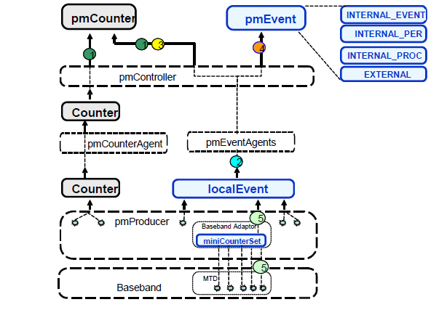
Current sample Aggregation period, UL
One sample in the current UL UE throughput distribution counter UeThpUlDistr is computed over the ROP period (15min) by omfPmBasebandAdaptor in OMF.
  UeThpUlDistr = hist(UE_volume_UL_15min / UE_time_UL_15min)
UE volume and active time are obtained by aggregating MCS counter samples from the baseband over the ROP. MCS counters are reported at each bbRopPeriod (1sec).
  UE_volume_UL_15min = sum(UE_volume_UL_1sec), UE_time_15min = sum(UE_time_UL_1sec)
Samples for the UE transmitted volume and active time averaged over bbRopPeriod (1 sec) are available in OMF but only aggregated values over 15 min are used in the distribution samples.
Reporting period for the throughput samples: ROP (15 min)
Reporting period for the volume and time MCS counters: bbRopPeriod (1 sec)
Notes:
2014-11-12
PPS Adjusted DL and UL Throughput metrics
75/0363-10/FCP 130 4300/14 Uen, Rev PA47

Slide 43
Shorter sample Aggregation period, UL
Proposal: use samples averaged over bbRopPeriod (1sec) for the new UL PDCP UE throughput distribution counters pmUeThpTtiFilteredUlDistr and pmUeThpTotalUlDistr.
Solution:
  Introduce a histogram counter per cell in omfPmBasebandAdaptor
    E.g. define EVENT_PARAM_PER_UE_THP_FILTERED_UL_DRB_BIN_x_XL and EVENT_PARAM_PER_UE_THP_TOTAL_UL_DRB_BIN_x_XL, x=0..N
  Compute a throughput sample averaged over bbRopPeriod after each MCS report from the baseband and add it to the histogram
    UL_Thp_Filtered_1sec = EVENT_PARAM_PER_UE_THP_PDCPVOL_TRUNK_UL / EVENT_PARAM_PER_UE_THP_TIME_UL
    Increment EVENT_PARAM_PER_UE_THP_FILTERED_UL_DRB_BIN_x_XL if UL_Thp_Filtered_1sec is in the range of bin x
  Report the histogram in the local event LOCAL_PER_BB_UE_ON_CELL_LEVEL_EVENT at the end of UE session or at the end of ROP session
Notes:
2014-11-12
PPS Adjusted DL and UL Throughput metrics
75/0363-10/FCP 130 4300/14 Uen, Rev PA47

Slide 44
New counters in DL
No | Counter | Type in cost est | Definition
1 | pmRadioThpTimeTotalDl | MAC | The effective DL MAC active time comprises of time periods from when the first piece of data in a data burst on MAC layer is transmitted until the buffer is emptied including the TTI when the buffer is emptied. When carrier aggregation is used, the effective active time on any of the carriers is measured. Unit: 1 ms
2 | pmRadioThpTimeTotalDlSamp | MAC | Number of time periods aggregated in the effective DL MAC active time during the measurement time interval. One time period starts when the first piece of data in a data burst on MAC layer is transmitted and ends when the buffer is emptied including the TTI when the buffer is emptied. Unit: 1
3 | pmDrbThpTimeTotalDlQci | MAC | The effective DL MAC active time used for DL DRB Throughput per QCI. It comprises of time periods from when the first piece of data in a data burst is transmitted until the buffer is emptied including the TTI when the buffer is emptied. Unit: 1 ms
4 | pmRlcArqStatusDlVol | PDCP (RLC) | The total volume of UL RLC AM Status PDUs transmitted in the downlink direction. Unit: 1 kilobit (1 000 bits)
Notes:
2014-11-12
PPS Adjusted DL and UL Throughput metrics
75/0363-10/FCP 130 4300/14 Uen, Rev PA47

Slide 45
New counters in DL cont.
No | Counter | Type in cost est | Definition
5 | pmUeThpTtiFilteredDlDistr | Cell | Distribution of the DL UE throughput. One DL UE throughput sample is obtained by dividing the total volume (PDCP SDU) on Data Radio Bearers per UE that has been transferred (UM and AM) in the downlink direction excluding the TTI when the buffer is emptied, with a time interval applicable to the volume measurement excluding the TTI when the buffer is emptied.
6 | pmUeThpTotalDlDistr | Cell | Distribution of the DL UE throughput. One DL UE throughput sample is obtained by dividing the total volume (PDCP SDU) on Data Radio Bearers per UE that has been transferred (UM and AM) in the downlink direction, with a time interval applicable to the volume measurement.
7 | pmRadioThpTimeTotalDlDistr | Cell | Distribution of the effective DL MAC active time. One sample is obtained by aggregating time periods for the active time over the measurement period. One time period starts when the first piece of data in a data burst on MAC layer is transmitted and ends when the buffer is emptied including the TTI when the buffer is emptied.
8 | pmRadioThpVolDlDistr | Cell | Distribution of the successfully transferred data volume on MAC level in the downlink including possible padding bits. One sample is obtained by aggregating the volume over the measurement period.
Notes:
2014-11-12
PPS Adjusted DL and UL Throughput metrics
75/0363-10/FCP 130 4300/14 Uen, Rev PA47

Slide 46
New Kpis in DL
DL MAC UE Throughput =
pmRadioThpVolDl / pmRadioThpTimeTotalDl
DL PDCP UE Throughput =
pmPdcpThpVolDl / (pmRadioThpTimeTotalDl + pmPdcpLatTimeDl)
DL PDCP UE Throughput per QCI =
pmPdcpVolDlQci / (pmDrbThpTimeTotalDlQci + pmPdcpLatTimeDlQci)
Average DL MAC UE burst volume = pmRadioThpVolDl / pmRadioThpTimeTotalDlSamp
Average DL MAC UE burst active time = pmRadioThpTimeTotalDl / pmRadioThpTimeTotalDlSamp
pmUeThpTtiFilteredDlDistr
pmUeThpTotalDlDistr
New counters are marked in blue.
Notes:
2014-11-12
PPS Adjusted DL and UL Throughput metrics
75/0363-10/FCP 130 4300/14 Uen, Rev PA47

Slide 47
Proposal, DL MAC throughput
MR23736: New throughput metrics shall be available on MAC level that reflects air interface performance.
  Solution: Introduce total DL MAC active time per UE and QCI. The same triggering conditions as in the baseline but no filtering on the “last transmission”. To be investigated if HARQ retransmissions for the last transmitted PDU can be included.
    dlMacTime, dlMacTimeQci
    Counters per QCI are preferable on PDCP layer not on MAC. To be introduced: DL MAC active time counters per QCI. But no MAC volume counters per QCI. (Since it is proposed to estimate PDCP active time by MAC active time).
Notes:
PPS Adjusted DL and UL Throughput metrics
2014-11-12
75/0363-10/FCP 130 4300/14 Uen, Rev PA47
LTE System Design Process - Pre-prestudy
2/155 01-FCP 103 7306 Uen, Rev PD3

Slide 48
DL MAC UE throughput
Re-use the existing DL MAC UE volume counter pmRadioThpVolDl
New DL MAC UE active time counter pmRadioThpTotalTimeDl. The same start conditions as for pmUeThpTimeDl but no filtering on the last transmission.
  Measurement is performed on MAC layer after logical channel multiplexing but before mapping to the transport channels
  Only Priority Queues for DRBs should be checked to avoid counting active time for SRBs (not clear if it is done in the baseline)
  Baseline: for a particular UE, EVENT_PARAM_PER_UE_THP_TIME_DL is incremented with 1 if that UE has data in buffer in any of its Priority Queues within a TTI once the isBearerForPmActive is enabled.
  Changed stopping condition: when the last HARQ ACK is received instead when the SDU buffer is emptied
  Do not count the time since the last transmission until the last HARQ ACK
First data transmitted:
start the active time counter and
increment the sample counter
pmRadioThpTimeTotalDlSamp
All PQs empty:
stop the active time counter, remove the acknowledgment delay
Time until scheduled pmPdcpLatTimeDl
pmRadioThpTimeTotalDl
DRB1
Data in the PDCP SDU buffer (DRB1)
PDSCH data
PDSCH data
PDSCH data
PDSCH data (SDU buffer empty)
NACK
PDSCH data (re-rx)
ACK
DRB2
Data in the PDCP SDU buffer (DRB2)
PDSCH data
PDSCH data
PDSCH data (SDU buffer empty)
ACK
Notes:
PPS Adjusted DL and UL Throughput metrics
2014-11-12
75/0363-10/FCP 130 4300/14 Uen, Rev PA47
LTE System Design Process - Pre-prestudy
2/155 01-FCP 103 7306 Uen, Rev PD3

Slide 49
DL MAC active time per QCI
New DL MAC UE active time counter pmDrbThpTotalTimeDlQci.The same start conditions as for pmDrbThpTimeDlQci but no filtering on the TTIs after the next to the last transmission before emptying the PDCP buffer.
  Baseline: for a particular UE and a particular DRB, EVENT_PARAM_PER_DRB_THP_TIME_DL is incremented with 1 if that UE has data in buffer in that particular DRB within a TTI once the isDrbForPmActive is enabled.
  Changed stopping condition: when the last HARQ ACK is received instead when the SDU buffer is emptied
  Do not count the time since the last transmission until the last HARQ ACK
PQ empty:
stop the active time counter, remove the acknowledgment delay
Time until scheduled pmPdcpLatTimeDlQci[drb1]
pmDrbThpTimeTotalDlQci[drb1]
DRB1
Data in the PDCP SDU buffer (DRB1)
PDSCH data
PDSCH data
PDSCH data
PDSCH data (SDU buffer empty)
NACK
PDSCH data (re-rx)
ACK
pmPdcpLatTimeDlQci[drb2]
pmDrbThpTimeTotalDlQci[drb2]
DRB2
Data in the PDCP SDU buffer (DRB2)
PDSCH data
PDSCH data
PDSCH data (SDU buffer empty)
ACK
Notes:
PPS Adjusted DL and UL Throughput metrics
2014-11-12
75/0363-10/FCP 130 4300/14 Uen, Rev PA47
LTE System Design Process - Pre-prestudy
2/155 01-FCP 103 7306 Uen, Rev PD3

Slide 50
Number of DL MAC bursts
New DL MAC counter pmRadioThpTimeTotalDlSamp is proposed providing information on the average MAC bursts observed during ROP.
    A data burst on a certain buffer on a certain protocol layer is defined as data received from when the buffer becomes non-empty until the buffer becomes empty again. A data burst is characterized by its volume and active time.
      pmRadioThpTimeTotalDlSamp: Number of effective active time periods aggregated in the unfiltered DL MAC active time counter pmRadioThpTimeTotalDl during the measurement time interval.
Counter pmRadioThpTimeTotalDlSamp has the same triggering condition as pmRadioThpTimeTotalDl except that it is just incremented with 1 at each triggering occasion.
The average DL MAC burst during the 15min ROP period may be characterized by
    Average DL MAC burst volume = pmRadioThpVolDl / pmRadioThpTimeTotalDlSamp
    Average DL MAC burst active time = pmRadioThpTimeTotalDl / pmRadioThpTimeTotalDlSamp
MAC burst samples:1
MAC burst samples:2
MAC burst samples:3
MAC SDU delivered volume
Vol(n)
Vol(n+2)
Vol(n+3)
Vol(n+5)
Vol(n+1)
Vol(n+4)
MAC active time
Notes:
2014-11-12
PPS Adjusted DL and UL Throughput metrics
75/0363-10/FCP 130 4300/14 Uen, Rev PA47

Slide 51
Proposal, DL PDCP throughput
MR23736: New DL throughput metrics shall be defined on PDCP level that enable a higher alignment between network KPIs and end-user performance experience.
Solution: Introduce total DL PDCP active time per UE and QCI without filtering on the “last TTI” and the last transmission
Alternative1: count unfiltered volume on PDCP level and unfiltered active time on MAC level (current assumption)
  RLC status PDUs for the opposite link are counted as active time
  DL PDCP queueing delay is not included into MAC active time
Alternative2: count unfiltered volume on PDCP and unfiltered active time on PDCP level
  Additional time stamps on SDUs or PDUs are probably needed but not feasible due to BB memory limitations
Notes:
PPS Adjusted DL and UL Throughput metrics
2014-11-12
75/0363-10/FCP 130 4300/14 Uen, Rev PA47
LTE System Design Process - Pre-prestudy
2/155 01-FCP 103 7306 Uen, Rev PD3

Slide 52
Proposal, DL PDCP throughput cont.
Throughput distribution counters shall be provided for the new PDCP throughput metrics with a resolution high enough to track cell edge performance.
    Proposal: configurable bin sizes
      Define histogram bin ranges as MOM parameters but hardcode the maximum number of bins
    Proposal: shorter time averaging period for the histogram throughput samples
Differentiation based on QCI shall be provided.
  Provided today given that time is counted on MAC.
  Should be even more feasible if time is counted on PDCP.
Notes:
PPS Adjusted DL and UL Throughput metrics
2014-11-12
75/0363-10/FCP 130 4300/14 Uen, Rev PA47
LTE System Design Process - Pre-prestudy
2/155 01-FCP 103 7306 Uen, Rev PD3

Slide 53
Alt1: DL PDCP volume +DL MAC active time
Alternative1: count unfiltered volume on PDCP level and unfiltered active time on MAC level
Identified issues:
  RLC status PDUs for the opposite link are counted as active time
    Possible solution: Count the relative status PDU volume overhead, and use this to compensate the active time. I.e., compute the PDCP-throughput estimate as
      pdcpThroughput = pdcpVolume / (macActiveTime * (1- rlcStatusPduVol / rlcTotalPduVolume))
    Alternative solution:
      Detect RLC status PDUs on MAC and do not count active time for those. E.g. MAC in UPC can detect RLC ACKs by checking MAC SDU size.
    DL PDCP queueing delay is not included into MAC active time
    Possible solution: those delays are counted into the existing counter pmPdcpLatTimeDl which could be included into the DL PDCP KPI.
      pdcpThroughput = pdcpVolume / (macActiveTime + pmPdcpLatTimeDl)
Notes:
2014-11-12
PPS Adjusted DL and UL Throughput metrics
75/0363-10/FCP 130 4300/14 Uen, Rev PA47

Slide 54
New DL counters per cell
New counters per cell:
  Distribution for DL UE PDCP throughput “filtered on the last TTI” per cell (new granularity):
    pmUeThpTtiFilteredDlDistr = hist(DL PDCP UE Throughput no last TTI)
  Distribution for the “unfiltered” DL UE PDCP throughput per cell:
    pmUeThpTotalDlDistr = hist(DL PDCP UE Throughput including the last TTI)
Notes:
2014-11-12
PPS Adjusted DL and UL Throughput metrics
75/0363-10/FCP 130 4300/14 Uen, Rev PA47

Slide 55
Increased resolution for the distributions, DL
Bin sizes for the current UE throughput distribution counter pmUeThpDlDistr are too large, especially for the low data rates.
  Bin sizes are variable but ranges are hardcoded in the code, OSS and ENIQ
Options for the new distribution counters for UE PDCP throughput in DL:
  Alt1 (current assumption) Configurable bin ranges with fixed maximum number of bins
    Define histogram bin ranges as MOM parameters but fix the maximum number of bins
      Maximum number of bins is hardcoded in the code, 10/ document, OSS and ENIQ. Define thp_bin_0..thp_bin_N in the 10/ document. Several “profiles” could be configured.
    Issues: it is not clear if ENIQ can read the MOM attributes.
  Alt2 Configurable bin ranges with variable number of bins
    Issues: variable number of bins is not supported in the 10/ document
  Alt3 Compressed counters with large number of small bins
    Define large number of bins with small sizes, say 1kbit, but use compressed counters.
    Issues: With increasing data rates, the number of non-zero bins will be increasing
  Alt4 Add new hardcoded bins to the current histogram
    Issues: With constantly increasing data rates, yet new bins will be needed in the high rate ranges.
Notes:
2014-11-12
PPS Adjusted DL and UL Throughput metrics
75/0363-10/FCP 130 4300/14 Uen, Rev PA47

Slide 56
Current sample Aggregation period, DL
One sample in the current DL UE throughput distribution counter UeThpDlDistr is computed over the ROP period (15min) by omfPmBasebandAdaptor in OMF.
  UeThpDlDistr = hist(UE_volume_DL_15min / UE_time_DL_15min)
UE volume and active time are obtained by aggregating MCS counter samples from the baseband over the ROP. MCS counters are reported at each bbRopPeriod (1sec).
  UE_volume_DL_15min = sum(UE_volume_DL_1sec), UE_time_15min = sum(UE_time_DL_1sec)
Samples for the UE transmitted volume and active time averaged over bbRopPeriod (1 sec) are available in OMF but only aggregated values over 15 min are used in the distribution samples.
Reporting period for the throughput samples: ROP (15 min)
Reporting period for the volume and time MCS counters: bbRopPeriod (1 sec)
Notes:
2014-11-12
PPS Adjusted DL and UL Throughput metrics
75/0363-10/FCP 130 4300/14 Uen, Rev PA47

Slide 57
Shorter sample Aggregation period, DL
Proposal: use samples averaged over bbRopPeriod (1sec) for the new DL PDCP UE throughput distribution counters pmUeThpTtiFilteredDlDistr and pmUeThpTotalDlDistr.
Solution:
  Introduce a histogram counter per cell in omfPmBasebandAdaptor
    E.g. define EVENT_PARAM_PER_UE_THP_FILTERED_DL_DRB_BIN_x_XL and EVENT_PARAM_PER_UE_THP_TOTAL_DL_DRB_BIN_x_XL, x=0..N
  Compute a throughput sample averaged over bbRopPeriod after each MCS report from the baseband and add it to the histogram
    DL_Thp_Filtered_1sec = (sum_DRB_AM( EVENT_PARAM_PER_DRB_PDCP_ACKVOL_DL- EVENT_PARAM_PER_UE_THP_PDCPVOL_TRUNK_DL) + sum_DRB_UM(EVENT_PARAM_PER_DRB_PDCP_TRANSVOL_DL)) / EVENT_PARAM_PER_UE_THP_TIME_DL
    Increment EVENT_PARAM_PER_UE_THP_FILTERED_DL_DRB_BIN_x_XL if DL_Thp_Filtered_1sec is in the range of bin x
  Report the histogram in the local event LOCAL_PER_BB_UE_ON_CELL_LEVEL_EVENT at the end of UE session or at the end of ROP session
Notes:
2014-11-12
PPS Adjusted DL and UL Throughput metrics
75/0363-10/FCP 130 4300/14 Uen, Rev PA47

Slide 58
Aggregation OF throughput kpiS
Currently, average UE (or RB or LCG) throughput KPIs are aggregated per cell weighted on the active time:
  UE throughput KPI = sum_UE(UE_volume_15min) / sum_UE(UE_time_15min) =
  sum_UE(UE_volume_15min / UE_time_15min * Weight(UE)) / N_UE,
  where Weight(UE) = N_UE * UE_time_15min / sum_UE(UE_time_15min)
  Hence samples with longer transmission time have higher weight
An alternative would be to aggregate as a simple throughput average over time and over UEs (or RBs or LCGs) per cell:
  Alt1) UE throughput KPI = sum_UE(UE_volume_15min / UE_time_15min) / N_UE
  Alt2) UE throughput KPI = sum_UE( sum(UE_volume_1sec / UE_time_1sec) /900) / N_UE
  Alt3) UE throughput KPI = sum_UE( sum(UE_volume_burst/ UE_time_burst) /N_burst) / N_UE
Example:
  UE1 has transmitted Volume1=800 kbits in total during Time1=0.2 s in one 1 sec period and UE2 has transmitted Volume2=80kbits in total during Time2=0.008s in one 1 sec period
  Thp_UE1 = Volume1/Time1 = 4 Mbps, Thp_UE2 = Volume2/Time2 = 10 Mbps
  Thp_time_weighted_average = (Volume1+Volume2)/(Time1+Time2) = 4.23 Mpbs
  Thp_vol_weighted_average = (Volume1/Time1*Volume1 *2+ Volume2/Time2*Volume2*2) / (2*(Volume1+Volume2)) )= 4.55 Mpbs
  Thp_average = (Volume1/Time1+Volume2/Time2) / 2= 7 Mpbs
Notes:
2014-11-12
PPS Adjusted DL and UL Throughput metrics
75/0363-10/FCP 130 4300/14 Uen, Rev PA47

Slide 59
Issues, Proposed solution DL
Should HARQ retransmissions be included in DL MAC active time? Most probably not included in the baseline.
  Then pegging requires “backdate” pegging when HARQ ACK is received not when SDU buffer is empty. Maybe it is enough to include HARQ ACK delay and stop the counter at the last HARQ ACK?
  Does volume counters include HARQ retransmissions?
  How to include HARQ retransmissions in TDD?
DL PDCP active time estimated by DL MAC active time
  Is a new counter for the RLC status PDU volume needed per QCI?
  Is a new counter needed for the total RLC PDU volume? PDCP SDU volume pmPdcpVolDlDrb could be enough when RLC status PDU volume is evaluated.
PM events with shorter reporting period than 15min ROP
  PM events are currently not available for throughput per cell (“cell trace” scanner). May decrease performance?
  PM events sampled at 1 sec intervals are available per UE (“UE trace” scanner, up to 16 UEs). (PM event INTERNAL_PER_UETR_UE_TRAFFIC_REP)
DL MAC throughput counters per QCI?
  No. Counters per QCI are preferable on PDCP layer not on MAC. To be introduced: DL MAC active time counters per QCI. But no MAC volume counters per QCI. Since it is proposed to estimate PDCP active time by MAC active time.
Notes:
PPS Adjusted DL and UL Throughput metrics
2014-11-12
75/0363-10/FCP 130 4300/14 Uen, Rev PA47
LTE System Design Process - Pre-prestudy
2/155 01-FCP 103 7306 Uen, Rev PD3

Slide 60
Issues, Proposed solution DL, Cont.
Filtering on the last TTI for 3GPP compliance?
  No. At least not on MAC.
Should padding be included into DL MAC volume?
  should be the same solution as in UL
Do any border effects exist for filtering on the end of MCS reporting periods?
Carrier aggregation. DL MAC active time per carrier?
  DL PDPC volume pmPdcpVolDlDrb, DL MAC volume pmRadioThpVolDl and filtered DL MAC active time pmUeThpTimeDl count on both carriers
  DL MAC volume on the primary cell: pmRadioThpVolDl-pmRadioThpVolDlSCell, but no active time for the primary cell
  DL MAC volume on the secondary cell by pmRadioThpVolDlSCell, but no active time for the secondary cell
Carrier aggregation on 2 DUs
TDD
TDD+FDD
TDD+FDD Carrier aggregation
Notes:
PPS Adjusted DL and UL Throughput metrics
2014-11-12
75/0363-10/FCP 130 4300/14 Uen, Rev PA47
LTE System Design Process - Pre-prestudy
2/155 01-FCP 103 7306 Uen, Rev PD3

Slide 61
Issues, Proposed solution DL, Cont. 2
Packet forwarding
  Unclear impact. MOM for pmPdcpLatTimeDl: “Due to packet forwarding, the target cell might have to buffer data before it is possible to schedule the UE in the target cell, hence it would be an increased Latency measurement if it would be included.”
AQM
  Unclear impact
Are burst volume and active time distribution counters needed?
  The current MCS reporting mechanism allows bbRopPeriod (1sec) aggregation period at the best. Otherwise, distribution counters for active time and volume for each burst per UE and per RB (LCG) are needed.
Notes:
PPS Adjusted DL and UL Throughput metrics
2014-11-12
75/0363-10/FCP 130 4300/14 Uen, Rev PA47
LTE System Design Process - Pre-prestudy
2/155 01-FCP 103 7306 Uen, Rev PD3

Slide 62
Costs, UL
Link to Cost One Pager, UL
Summary of costs
  Prestudy:
    System: MAC 80, PDCP 100, Cell 80, Total 260
    Simulation: MAC 100, PDCP 80, Cell 40, Total 220
    MBB: MAC 10, PDCP 10, Cell 10, Total 30
    SAM: MAC 0, PDCP 0, Cell 10, Total 10
  PD
    CPI: MAC 20, PDCP 20, Cell 20, Total 60
    MBB:
      MBB Systemization: MAC 60, PDCP 60, Cell 80, Total 200
      MBB L2: MAC 30, PDCP 30, Cell 30, Total 90
      OBS: MAC 100, PDCP 120, Cell 150, Total 370
    SAM:
      SAM Systemization: MAC 0, PDCP 0, Cell 80, Total 80
      PDCP RLC: MAC 0, PDCP 100, Cell 0, Total 100
    Config & OAM:
      Config & OAM Systemization: MAC 0, PDCP 0, Cell 30, Total 30
      LRAT:
        OMF: MAC 0, PDCP 0, Cell 60, Total 60
Continued on the next page
Notes:
PPS Adjusted DL and UL Throughput metrics
2014-11-12
75/0363-10/FCP 130 4300/14 Uen, Rev PA47
LTE System Design Process - Pre-prestudy
2/155 01-FCP 103 7306 Uen, Rev PD3

Slide 63
Costs, UL Cont.
Summary of costs continued
    Verification
      Test analysis MAC 30, PDCP 30, Cell 30, Total 90
      Feature Verification MAC 120, PDCP 30, Cell 60, Total 210
      Legacy Test development MAC 20, PDCP 20, Cell 20, Total 60
      IODT MAC 30, PDCP 30, Cell 0, Total 60
      BPV MAC 10, PDCP 10, Cell 10, Total 30
      SV System MAC 10, PDCP 10, Cell 10, Total 30
      CIRV MAC 30, PDCP 30, Cell 30, Total 90
    OSS MAC 30, PDCP 30, Cell 30, Total 90
Subtotal: MAC 680+ PDCP 710 + Cell 780
Total: 2170 mhs
Notes:
PPS Adjusted DL and UL Throughput metrics
2014-11-12
75/0363-10/FCP 130 4300/14 Uen, Rev PA47
LTE System Design Process - Pre-prestudy
2/155 01-FCP 103 7306 Uen, Rev PD3

Slide 64
Costs, DL
Link to Cost One Pager, DL
Summary of costs
  Prestudy:
    System: MAC 80, PDCP 100, Cell 50, Total 230
    Simulation: MAC 100, PDCP 80, Cell 0, Total 180
    MBB: MAC 10, PDCP 10, Cell 10, Total 30
    SAM: MAC 0, PDCP 0, Cell 10, Total 10
  PD
    CPI: MAC 20, PDCP 20, Cell 20, Total 60
    MBB:
      MBB Systemization: MAC 30, PDCP 20, Cell 30, Total 80
      MBB L2: MAC 30, PDCP 30, Cell 30, Total 90
      OBS: MAC 100, PDCP 70, Cell 100, Total 270
    SAM:
      SAM Systemization: MAC 0, PDCP 0, Cell 80, Total 80
      PDCP RLC: MAC 0, PDCP 80, Cell 0, Total 80
    Config & OAM:
      Config & OAM Systemization: MAC 0, PDCP 0, Cell 30, Total 30
      LRAT:
        OMF: MAC 0, PDCP 0, Cell 60, Total 60
Continued on the next page
Notes:
PPS Adjusted DL and UL Throughput metrics
2014-11-12
75/0363-10/FCP 130 4300/14 Uen, Rev PA47
LTE System Design Process - Pre-prestudy
2/155 01-FCP 103 7306 Uen, Rev PD3

Slide 65
Costs, DL Cont.
Summary of costs continued
    Verification
      Test analysis MAC 30, PDCP 30, Cell 30, Total 90
      Feature Verification MAC 120, PDCP 30, Cell 50, Total 200
      Legacy Test development MAC 20, PDCP 20, Cell 20, Total 60
      IODT MAC 30, PDCP 30, Cell 0, Total 60
      BPV MAC 10, PDCP 10, Cell 10, Total 30
      SV System MAC 10, PDCP 10, Cell 10, Total 30
      CIRV MAC 30, PDCP 30, Cell 30, Total 90
    OSS MAC 60, PDCP 20, Cell 40, Total 120
Subtotal: MAC 680 + PDCP 590 + Cell 610
Total: 1880 mhs
Notes:
PPS Adjusted DL and UL Throughput metrics
2014-11-12
75/0363-10/FCP 130 4300/14 Uen, Rev PA47
LTE System Design Process - Pre-prestudy
2/155 01-FCP 103 7306 Uen, Rev PD3

Slide 66
STANDARDIZATION IMPACT
UL and DL PDCP throughput KPIs are defined in
  3GPP TS 36.314, Layer 2 - Measurements
No dependency on any new items.
Notes:
PPS Adjusted DL and UL Throughput metrics
2014-11-12
75/0363-10/FCP 130 4300/14 Uen, Rev PA47
LTE System Design Process - Pre-prestudy
2/155 01-FCP 103 7306 Uen, Rev PD3
A product feature has a 3GPP standards dependency if it relies on standardized signaling over an interface or on standardized behavior of a node. The standards dependency is critical if it relies on signaling between the terminal (UE) and the network or on standardized terminal (UE) behavior.
Note that even if the core standard is in place since long SWEA need to be informed to make sure that 3GPP RAN4* performance requirements and 3GPP RAN5** terminal conformance tests are in place.
Note also that SWEA can help with contacts to the Ericsson team that worked on the concept building and the standardization related to the 3GPP work item and with references to documentation of that work that may be very useful in the pre-pre study.
* RAN4 develops performance requirements for the terminal and the base station regarding radio TX/RX, measurement accuracies, mobility, new frequency bands and carrier aggregation band combinations etc. This is typically completed about half a year after the core specifications in RAN1 to RAN3 have been completed but if no company has any plans to implement the feature in their products it may be delayed until productification starts.
** RAN5 develops terminal conformance tests that a certified terminal must adhere too. This is typically not done until terminal manufacturers and network vendors start to implement the feature in order to make sure that the tests cover the components and configurations actually used in real products. Terminal conformance tests typically take RAN5 half a year to develop (assuming RAN4 requirements are ready) and they typically need to be ready half a year before Ericsson GA. The RAN5 terminal conformance tests are an important complement to IOT since it’s not possible for Ericsson to perform IOT with all terminal manufacturers.

Slide 67
Verification Aspects (OpTIONAL)
Description of special considerations that need to be taken
Link to OTAR
Notes:
PPS Adjusted DL and UL Throughput metrics
2014-11-12
75/0363-10/FCP 130 4300/14 Uen, Rev PA47
LTE System Design Process - Pre-prestudy
2/155 01-FCP 103 7306 Uen, Rev PD3

Slide 68
References
  Andreas Olsson AB, Integrity KPIs - Way forward, 27/0363-11/FCP 130 4300/13
  NDS LTE Observability (L10A), 9/102 68-FCP 103 7306
  CR4615 Throughput KPI changes, 4615/109 18-FCP 130 4300
  Markku Maijala, UE throughput
  Na Chen and Scott Jordan, Throughput in processor-sharing queues, IEEE Transactions on Automatic Control. 52 (2), pp. 299-305.
  PSS Quality of Service Observability in WDCMA, 134/102 68-FCP 121 7060
Notes:
2014-11-12
PPS Adjusted DL and UL Throughput metrics
75/0363-10/FCP 130 4300/14 Uen, Rev PA47

Slide 69
Generic PDCP throughput
PDCP throughput = PDCP volume / PDCP active time
PDCP volume (t)= sum_n=1..N(t) ( pdcpVol(n) )
PDCP active time (t) = sum_n=1..N(t) ( T_{Del}(n) – max(T_{Del}(n-1), T_{Arr}(n)) )
  Here N(t) is number of SDUs in the buffer at time t
  Note that T_{Del}(n-1) <=T_{Del}(n) always due to RLC in-sequence delivery
RLC SDU delivered volume
Vol(n)
Vol(n+2)
Vol(n+3)
Vol(n+5)
Vol(n+1)
Vol(n+4)
RLC active time
n+3
RLC SDU Tx buffer
n
n+2
n+4
n+5
n+1
RLC SDU delivery time
T_{Arr}(n)
T_{Del}(n)
T_{Arr}(n+1)
T_{Arr}(n+2)
T_{Del}(n+2)
T_{Arr}(n+4)
T_{Del}(n+3)
T_{Del}(n+4)
T_{Arr}(n+5)
T_{Del}(n+5)
T_{Arr}(n+3)
T_{Del}(n+1)
Notes:
PPS Adjusted DL and UL Throughput metrics
2014-11-12
75/0363-10/FCP 130 4300/14 Uen, Rev PA47
LTE System Design Process - Pre-prestudy
2/155 01-FCP 103 7306 Uen, Rev PD3

Slide 70



















Limitations for DL pdcp throughput
In DL, RLC SDU delivery time T_{Del} in the UE is not known at the eNodeB
  RLC SDU acknowledgment time T_{LastAck} occurs much later than RLC SDU delivery time T_{Del}(n) due to the delay until the RLC status PDU is received.
    The RLC status prohibit timer and RLC reordering timer: now 25 ms, up to 80ms
    During high load in UL, there is also scheduling delay for the RLC status PDUs, up to 200ms
RLC status prohibit timer + UL scheduling delay
SDU(n+1)
RLC SDU Tx buffer
SDU(n)
SDU(n+2)
RLC PDU Tx
RLC Control Rx
T_{Arr}
SDU(n) arrival
T_{Del}
SDU(n) delivered to the UE
T_{LastAck}
last retransmitted PDU in SDU(n) acknowledged
Notes:
2014-11-12
PPS Adjusted DL and UL Throughput metrics
75/0363-10/FCP 130 4300/14 Uen, Rev PA47

Slide 71






















Limitations for UL pdcp throughput
In UL, RLC SDU arrival time T_{Arr} in the UE is not known at the eNodeB
Arrival time of the SDU’s first PDU to MAC T_{ArrMac} and UE buffer status is not known on RLC layer. It has to be signaled or estimated.
RLC SDU Rx buffer
RLC PDU Rx
RLC Control Tx
MAC Rx
T_{ArrMac}
Arrival of the first PDU in SDU(n) to MAC
T_{ArrRlc}
Arrival of the first PDU in SDU(n) to RLC
T_{Del}
SDU(n) delivered to PDCP
Notes:
2014-11-12
PPS Adjusted DL and UL Throughput metrics
75/0363-10/FCP 130 4300/14 Uen, Rev PA47

Slide 72




Alt2: Time stamps for UL pdcp throughput
For each RLC SDU in UL, three time stamps are defined:
  Timestamp T_{ArrMac}: arrival time of the first PDU in the SDU to MAC
  Timestamp T_{ArrRlc}: arrival time of the first PDU in the SDU to RLC
  Timestamp T_{LastRx} : the SDU has been transmitted to PDCP
RLC SDU Rx buffer
RLC PDU Rx
RLC Control Tx
MAC Rx
Timestamp T_{ArrMac} Arrival of the first PDU in SDU(n) to MAC
Timestamp T_{ArrRlc} Arrival of the first PDU in SDU(n) to RLC
Timestamp T_{LastRx}
SDU(n) transmitted to PDCP
Notes:
2014-11-12
PPS Adjusted DL and UL Throughput metrics
75/0363-10/FCP 130 4300/14 Uen, Rev PA47

Slide 73
Alt2: UL PDCP active time
Do not count acknowledgement delays for the last PDU in the successfully delivered SDUs
pmDrbThp2TimeUl = sum_SDU (time_last_received(SDU))
Where:
  time_last_received(n) = T_{LastRx}(n)-max(T_{LastRx}(n-1), T_{ArrMac}(n))
Problem: T_{ArrMac} is not known on RLC layer. It has to be signaled or estimated.
  Possible solution: PDU time stamps
Notes:
2014-11-12
PPS Adjusted DL and UL Throughput metrics
75/0363-10/FCP 130 4300/14 Uen, Rev PA47

Slide 74











ALt2: Time stamps for DL pdcp throughput
For each RLC SDU in DL, four time stamps are defined:
  Timestamp T_{Arr}: arrival time of the SDU
  Timestamp T_{LastTx} : last in-sequence PDU in the SDU has been transmitted to MAC
  Timestamp T_{LastReTx} : last retransmitted PDU in the SDU has been transmitted to MAC
  Timestamp T_{LastAck} : last retransmitted PDU in the SDU has been acknowledged
SDU(n+1)
RLC SDU Tx buffer
SDU(n)
SDU(n+2)
RLC PDU Tx
RLC Control Rx
Timestamp T_{Arr} SDU(n) arrival
Timestamp T_{LastTx}
last PDU in SDU(n) transmitted to MAC
Timestamp T_{LastReTx}
last retransmitted PDU in SDU(n) transmitted to MAC
Timestamp T_{LastAck}
last retransmitted PDU in SDU(n) acknowledged
Notes:
2014-11-12
PPS Adjusted DL and UL Throughput metrics
75/0363-10/FCP 130 4300/14 Uen, Rev PA47

Slide 75
Alt2: DL PDCP active time
Do not count acknowledgement delays for the last PDU in the successfully delivered SDUs
pmDrbThp2TimeDl = sum_SDU_ACK (time_last_transmitted(SDU_ACK))
+ sum_SDU_no_ACK (time_acknowledged(SDU_no_ACK))
Here
  time_last_transmitted(n) = max(T_{LastTx}(n), T_{LastReTx}(n)) - max(T_{LastTx}(n-1), T_{LastReTx}(n-1), T_{Arr}(n))
  time_acknowledged(n) = T_{LastAck}(n) – max(T_{LastAck}(n-1), T_{Arr}(n))
Identified issue: additional time stamps on SDUs are probably needed but not feasible due to BB memory limitations.
  Available: SDU arrival time T_{Arr} and SDU acknowledgment time T_{LastAck} . Needed: time when SDUs last PDU transmitted T_{LastTx} and time when SDUs last PDU transmitted T_{LastReTx}
  Possible solution: PDU time stamps
Notes:
2014-11-12
PPS Adjusted DL and UL Throughput metrics
75/0363-10/FCP 130 4300/14 Uen, Rev PA47

Slide 76
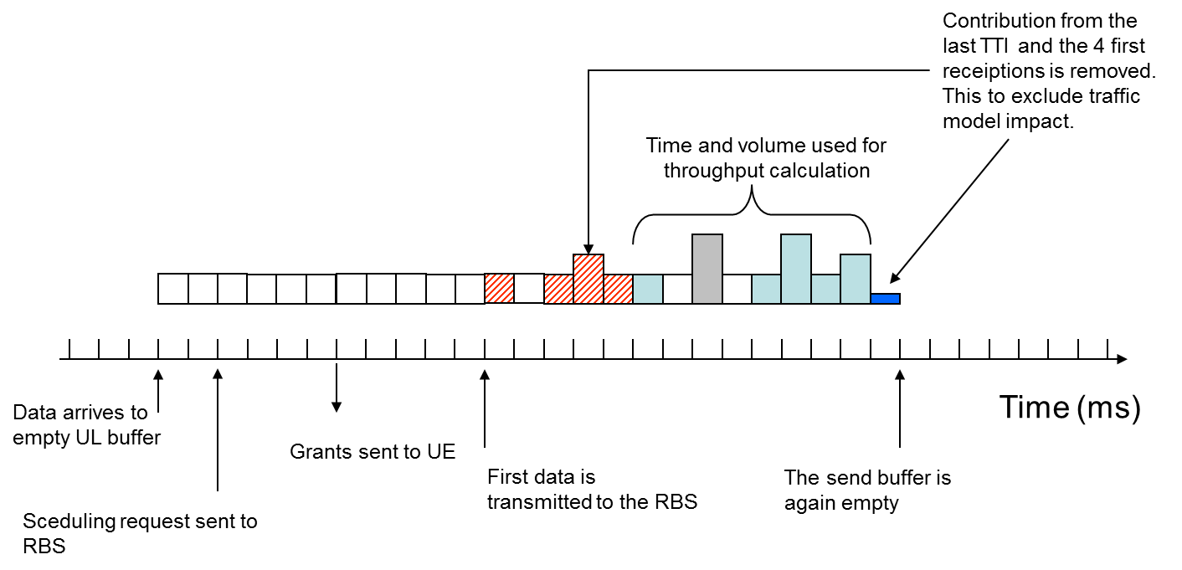
Current UL UE throughput
UL UE Throughput =
pmUeThpVolUl / (pmUeThpTimeUl/1000)
  pmUeThpVolUl UL MAC SDU volume excluding the volume received in the first 4 data receptions of an UL buffer transfer and the TTI emptying the UL buffer (measured on MAC)
  pmUeThpTimeUl UL MAC SDU active time excluding the first 4 data receptions of an UL buffer transfer and the TTI emptying the UL buffer (measured on MAC)
UL UE Throughput per LCG =
pmLcgThpVolUlLcg / (pmLcgThpTimeUlLcg/1000)
pmRadioThpVolUl total received UL MAC SDU volume
pmPdcpVolUlDrb total received UL PDCP SDU volume
Notes:
2014-11-12
PPS Adjusted DL and UL Throughput metrics
75/0363-10/FCP 130 4300/14 Uen, Rev PA47

Slide 77
Current counters, UL UE throughput
pmUeThpVolUl
  The UL DRB volume used for UL UE Throughput. It comprises of the MAC SDU volume received on Uu, excluding the volume received in the first 4 data receptions of an UL buffer transfer and the TTI emptying the UL buffer.
pmUeThpTimeUl
  The UL volume transfer time used for UL UE Throughput. It comprises of time periods from when the 5th MAC SDU data reception of an UL buffer transfer on Uu until the buffer is emptied, excluding the TTI emptying the buffer.
pmLcgThpVolUlLcg
  The UL volume used for UL DRB Throughput per LCG. It comprises of the MAC SDU volume received on Uu per LCG, excluding the volume received in the first 4 data transmissions and the data transmission emptying the UL buffer.
pmLcgThpTimeUlLcg
  The UL transmission time used for UL DRB Throughput per LCG. It comprises of time periods from when the 5th data transmission is received on Uu until the second last data transmission is received.
pmRadioThpVolUl
  The total successfully transferred data volume on MAC level in the uplink. This counter includes possible padding bits.
pmPdcpVolUlDrb
  The total volume (PDCP SDU) on Data Radio Bearers that has been received in the uplink direction and transmitted over the GTP-U.
pmPdcpVolUlDrbQci
  The total volume (PDCP SDU) that has been received on Data Radio Bearers in the uplink direction per QCI.
Notes:
2014-11-12
PPS Adjusted DL and UL Throughput metrics
75/0363-10/FCP 130 4300/14 Uen, Rev PA47

Slide 78
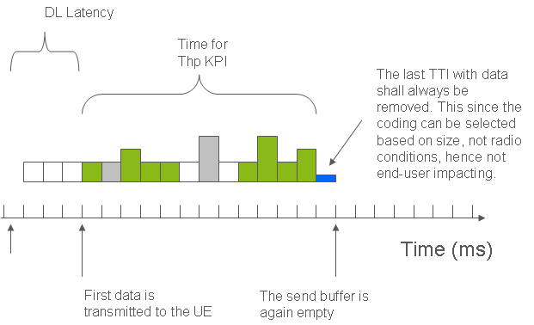
Current DL UE throughput
DL PDCP UE Throughput =
(pmPdcpVolDlDrb – pmPdcpVolDlDrbLastTTI ) / (pmUeThpTimeDl/1000)
  pmPdcpVolDlDrb total DL PDCP volume (measured on PDCP)
  pmPdcpVolDlDrbLastTTI DL PDCP volume transmitted in the TTIs when the last PDCP buffer is emptied (measured on MAC)
  pmUeThpTimeDl DL PDCP active time excluding the TTIs emptying the PDCP buffer (measured on MAC)
DL PDCP UE Throughput per QCI =
(pmPdcpVolDlDrbQci – pmPdcpVolDlDrbLastTTIQci ) / (pmDrbThpTimeDlQci/1000)
  pmDrbThpTimeDlQci DL PDCP active time excluding the TTIs after the next to the last transmission before emptying the PDCP buffer (measured on MAC)
pmRadioThpVolDl DL MAC Volume (on both the primary and secondary cell)
pmRadioThpVolDlSCell DL MAC Volume on the secondary cell
Notes:
2014-11-12
PPS Adjusted DL and UL Throughput metrics
75/0363-10/FCP 130 4300/14 Uen, Rev PA47

Slide 79
Current DL counters, PDCP throughput
pmPdcpVolDlDrb
  The total volume (PDCP SDU) on Data Radio Bearers that has been transferred (UM and AM) in the downlink direction.
pmPdcpVolDlDrbLastTTI
  The total volume (PDCP SDU) on Data Radio Bearers that has been transferred (acknowledged by the UE) in the downlink direction in the last TTI when a buffer is emptied.
pmUeThpTimeDl
  The effective DL transport time comprises those periods from when the first part of the PDCP SDU of the DL buffer was transmitted on Uu until the buffer is emptied, excluding the TTI emptying the buffer.
pmPdcpVolDlDrbQci
  The total volume (PDCP SDU) that has been transferred (UM and AM) on Data Radio Bearers in the downlink direction per QCI.
pmPdcpVolDlDrbLastTTIQci
  The total DL PDCP SDU volume per QCI that is transmitted in the last TTI when the buffer for a DRB that maps to the given QCI is emptied.
pmDrbThpTimeDlQci
  The DL transmission time used for DL DRB Throughput per QCI. It comprises of time periods from when the first piece of data in a data burst is transmitted until the second last piece of data in the data burst is transmitted.
Notes:
2014-11-12
PPS Adjusted DL and UL Throughput metrics
75/0363-10/FCP 130 4300/14 Uen, Rev PA47

Slide 80
Current DL counters, MAC throughput
pmRadioThpVolDl
  The total successfully transferred data volume on MAC level in the downlink. This counter includes possible padding bits.
pmRadioThpVolDlSCell
  The total successfully transferred data volume on MAC level in the downlink for secondary cell traffic (i.e. the UE has another cell as its primary component carrier (PCell)). This counter includes possible padding bits.
pmUeThpTimeDl
  The effective DL transport time comprises those periods from when the first part of the PDCP SDU of the DL buffer was transmitted on Uu until the buffer is emptied, excluding the TTI emptying the buffer.
  When carrier aggregation is used, a PDCP SDU can be sent over multiple cells (PCell/SCell(s)). The effective DL transport time, comprising those periods from when the first part of the PDCP SDU of the DL buffer was transmitted on Uu until the buffer is emptied, excluding the TTI emptying the buffer, is registered on PCell.
Notes:
2014-11-12
PPS Adjusted DL and UL Throughput metrics
75/0363-10/FCP 130 4300/14 Uen, Rev PA47

Slide 81
Current Cell throughput counters
pmUeThpDlDistr
  Distribution of the DL UE throughput. One DL UE throughput sample is obtained by dividing the total volume (PDCP SDU) on Data Radio Bearers per UE, that has been transferred (UM and AM) in the downlink direction, with a time interval applicable to the volume measurement.
pmUeThpUlDistr
  Distribution of the UL UE throughput. One UL UE throughput sample is obtained by dividing the total volume (PDCP SDU) on Data Radio Bearers per UE, that has been received in the uplink direction, with a time interval applicable to the volume measurement.
Notes:
2014-11-12
PPS Adjusted DL and UL Throughput metrics
75/0363-10/FCP 130 4300/14 Uen, Rev PA47

Slide 82
Next step
Type of activity/-ies (Study, Simulations, tests etc):
Target Deliverable:
Notes:
PPS Adjusted DL and UL Throughput metrics
2014-11-12
75/0363-10/FCP 130 4300/14 Uen, Rev PA47
LTE System Design Process - Pre-prestudy
2/155 01-FCP 103 7306 Uen, Rev PD3

Slide 83

Notes:
2014-11-12
PPS Adjusted DL and UL Throughput metrics
75/0363-10/FCP 130 4300/14 Uen, Rev PA47

Slide 84
Example: Carrier Aggregation
What DL UE throughput can we measure for carrier aggregation?
  radio throughput on the primary carrier?
    DL MAC volume given by pmRadioThpVolDl- pmRadioThpVolDlSCell, but no active time for the primary cell
  radio throughput on the secondary carrier?
    DL MAC volume given by pmRadioThpVolDlSCell, but no active time for the secondary cell
  aggregated “end-to-end” throughput?
    DL PDCP UE Throughput =
(pmPdcpVolDlDrb – pmPdcpVolDlDrbLastTTI ) / (pmUeThpTimeDl/1000)
    But pmUeThpTimeDl is filtered on the last TTI and measured on MAC. Queueing delays are not included. (Correct: measured both on the primary and secondary cell).
    Aggregated active time cannot be deduced from the total active time counters on the both carriers (will be even more complicated for TDD+FDD carrier aggregation)
Notes:
PPS Adjusted DL and UL Throughput metrics
2014-11-12
75/0363-10/FCP 130 4300/14 Uen, Rev PA47
LTE System Design Process - Pre-prestudy
2/155 01-FCP 103 7306 Uen, Rev PD3

Slide 85
Principals, Proposal
Split the throughput KPI into MAC (“radio”) throughput and PDCP (“end-to-end”) throughput
Remove filtering on the “first 4 TTIs” and the “last TTI” in UL and on the “last TTI” in DL
On the MAC layer, measure all the radio aspects in smallest possible detail. But include only the active active time into the MAC throughput KPI.
  I.e. measure the active active time, delays from the SR until grant assignment, delays from the grant assignment until data transmission, padding volume etc. in separate counters. Maybe also include padding into the volume (still to be discussed)?
On the PDCP level, include all the queuing delays into the PDCP active time and exclude padding from the volume.
  This should be a “radio agnostic” throughput KPI which may be used to measure total system characteristics, independently of any new features on the radio interface.
Notes:
PPS Adjusted DL and UL Throughput metrics
2014-11-12
75/0363-10/FCP 130 4300/14 Uen, Rev PA47
LTE System Design Process - Pre-prestudy
2/155 01-FCP 103 7306 Uen, Rev PD3

Slide 86
Proposal, DL MAC cont.
The metrics shall be available as counters and events.
  PM events are currently not available for throughput per cell (“cell trace” scanner). May decrease performance?
  PM events sampled at 1 sec intervals are available per UE (“UE trace” scanner, up to 16 UEs)
Existing counters shall be maintained.
  OK
Burst length metric shall be provided on MAC level. (optional)
  This requirement was removed after meeting with Paul T., 2014-08-12.
Notes:
PPS Adjusted DL and UL Throughput metrics
2014-11-12
75/0363-10/FCP 130 4300/14 Uen, Rev PA47
LTE System Design Process - Pre-prestudy
2/155 01-FCP 103 7306 Uen, Rev PD3

